Slide 1
Quality Control Summary
Alexander Keyel
As of 2023-08-28

Slide 2
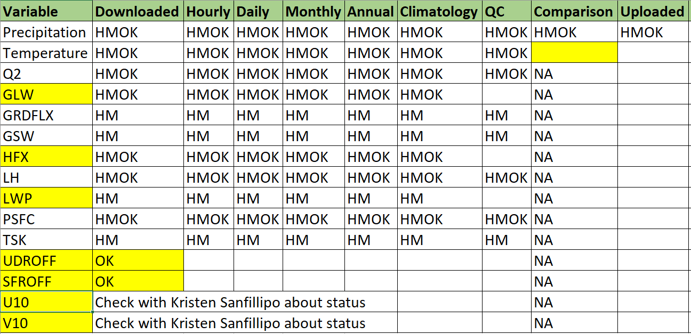
2D Data: Overview
???
*
*
*
**
**
* Not in USGS data set for Oahu and Kauai. ** Not in USGS data set for Hawaii and Maui

Slide 3
Annual Climatologies (20 years)
Cumulative for Precipitation, Surface runoff and UDROFF
Mean, Min, Max for all other variables

Slide 4
Precipitation (mm): Present
Maui
Oahu
Kauai
Hawaii

Slide 5
Precipitation (mm): RCP 4.5
Maui
Oahu
Kauai
Hawaii

Slide 6
Precipitation (mm): RCP 8.5
Maui
Oahu
Kauai
Hawaii

Slide 7
Temperature (K)
MAXIMUM
MEAN
MINIMUM

Slide 8
Q2

Slide 9
GLW

Slide 10
GRDFLX

Slide 11
GSW

Slide 12
HFX

Slide 13
LH

Slide 14
LWP

Slide 15
PSFC

Slide 16
TSK

Slide 17
PENDING: UDROFF, SFROFF, U10, V10

